Slide 1



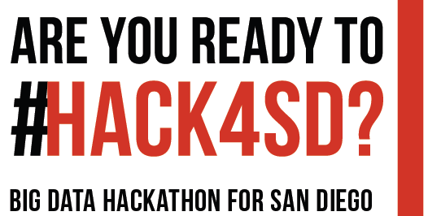

Please Tweet about this event with #HACK4SD

Slide 2



Round 2 Orientation and Details
Co-organizers
Dr. Amy Schmitz Weiss (Journalism and Media Studies)
Dr. Ming Tsou (HDMA Center, Geography)
Dr. Atsushi Nara (HDMA Center, Geography)
Dr. Adam Hammond (English, Digital Humanities)

Slide 3
Participant Agreement
The Intellectual Property of Codes and Apps created within this Hackathon will be Open Source and Accessible for San Diego Community.
All outputs and codes should be saved in the San Diego Big Data Hackathon Github Repositories, which are Open Source with Creative Commons Licenses. There is enormous value to the San Diego community by having an open repository of these outputs and codes.
The hackathon is open to all individuals at least 13 years of age at the time of entry.
To participate, you must be able to attend the Hackathon in person in San Diego (no remote participation).
Other items (See the actual Participant Agreement Form).
Please Sign it and Return to our Hackathon Organizers / Volunteers (Who wear the White Hackathon T-shirt).

Slide 4
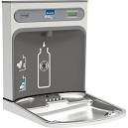
Food and Drinks:
Water Bottle: Please use Marker to Write your name and Refill it on the refill station.
No food INSIDE this Class Room.
Please consume food at the Hallway or Outside. Thank you.
Two Coffee Break (morning and afternoon).
Lunch : Pizza and Potato Chips

Slide 5



Watch Your Belongings
We are not responsible for your personal items left in the Room. Please don’t leave your important devices unattended.

Slide 6
Free SDSU Guest Wi-Fi Access
1. Make sure the Internet Browser and all of the tabs or windows are closed.
2. Locate your WiFi menu/access.
3. Select SDSU_Wireless
4. Open your Internet browser. “Welcome to SDSU“ should appear.
5. Click on Guests.
6. Enter in your Full Name.
7. Enter in your Cell Phone number.
8. Select your Mobile Carrier from the list. You will not be able to connect to the university’s network, if your Cellular Service Provider is not in the Mobile Carrier list, your cellular service or phone does not accept SMS text messages or you do not have a cellular phone.
9. Enter your Email Address. This will become your username to log into the network
10. Read and Accept the SDSU terms of use
11. Click Register.
12. Check you cell phone for a text message from wifi-registration@sdsu.edu. In the text message you will find the username and password to enter into SDSU_Wireless web page.

Slide 7
Saturday Schedule:
9-10 a.m.
Round 2 Orientation
Eric Busboom Presentation
Tech Q&A
10 a.m. – 12 p.m. Mentor meeting with teams
12-1 p.m. (Lunch – pizza!)
1-5 p.m. Learning Stations, Hacking/Teamwork Time
5-6 p.m. Team check-in with organizers

Slide 8
Tools http://bigdataforsandiego.github.io/#tools
(Software Development Tools, Presentation, Hosting, File Sharing, Could Data Storage, Project Management)
Free Amazon EC2 Student Account Credits ($100): For new students who would like to request credits for the hackathon, click here:
(Available in Github → 00-Proposal-Template → URL link )
https://www.awseducate.com/Application?apptype=student&promoCode=sdsu-hackathon-2017

Slide 9
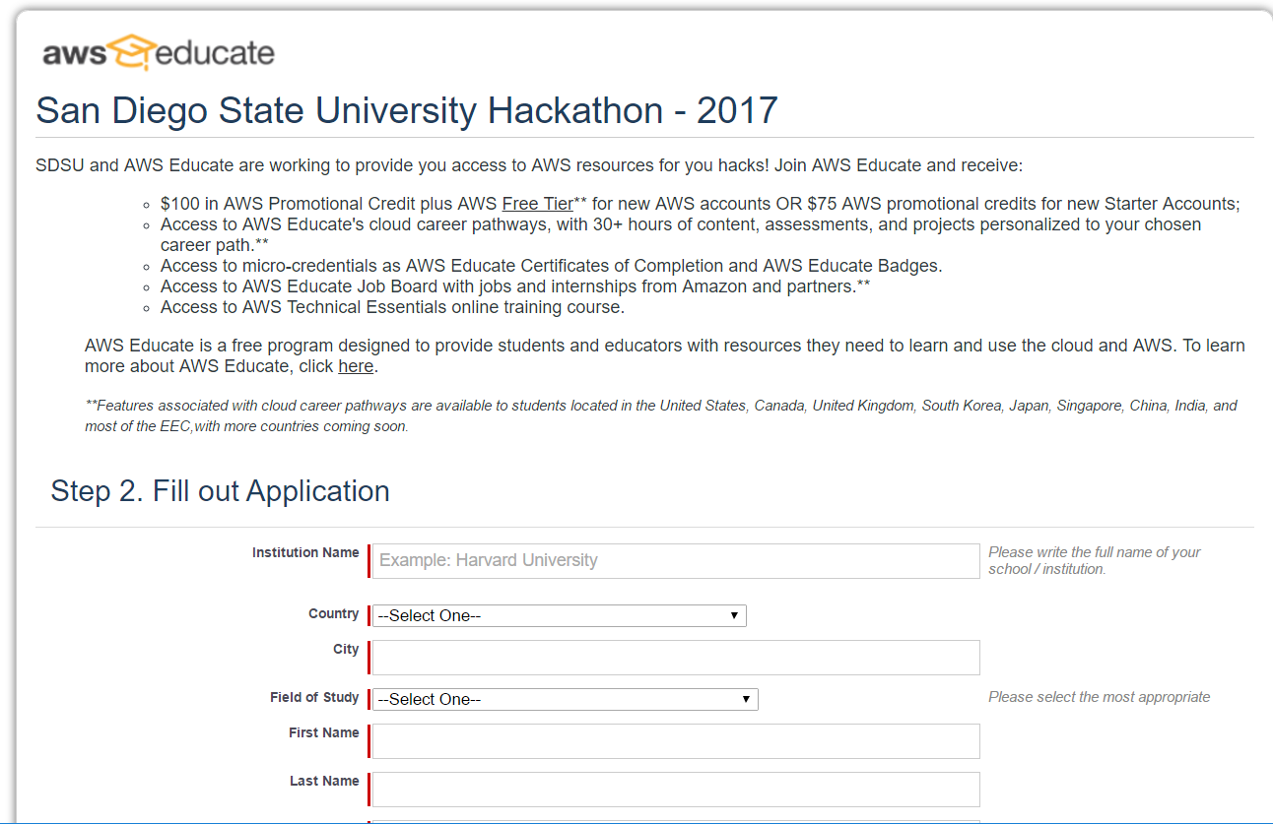
Please Select An AWS Educate Starter Account
(without using Credit card info). DO NOT enter any credit card info!!!

Slide 10
Thanks to our Mentors
Dr. Ming-Hsiang (Ming) Tsou (Geography, SDSU), Professor)
Dr. Ilkay Altintas (San Diego Supercomputer Center)
Nancy J. Jones, CMA, MBA
Caroline A. Thompson, PhD, MPH (Graduate School of Public Health, SDSU)
Melody Schiaffino, PhD, MPH (Graduate School of Public Health, SDSU)
Eric R. Buhi, PhD, MPH (Graduate School of Public Health, SDSU)

Slide 11
YOUR INNOVATION CAN WIN PRIZES
Best Overall Projects:
1st Prize: $600
2nd Prize: $300
3rd Prize: $150
Most innovative idea: $100
Strongest teamwork: $100
Most Design and Development: $150

Slide 12
Judging Criteria
Teams will be judged on the following:
Quality of idea
Innovativeness/creativity of the idea
Readiness of the idea to go to market
Impact of idea on public health field
The demonstration of teamwork/collaboration
The development and design of the idea (can include code but not required)

Slide 13
Preparing for Sunday
Submit your Final Pitch Presentation and Project Submission File by 12 p.m. on GitHub in your team folder
Project Submission File should be filled in (located on Github)
Pitch Presentation should be a PowerPoint slide presentation (no more than 5 slides) and should include:
Team Name, Team Members
The public health question you are answering/problem you are solving
The name of the project/idea
The datasets you are using and/or creating
The premise of the project/idea and how it would work (prototype provided, code shown or demonstration)
The impact of this project/idea on public health in general
The next steps to launch the project/idea
Presentation should be visually appealing and concise.
You will have 5 minutes to present your idea, 5 minutes for the judges to ask questions. Teams will be assigned their presentation time slot on Sunday morning. Presentations will begin at 1 p.m.

Slide 14


Silver Sponsors

Slide 15








Bronze Sponsor

Slide 16
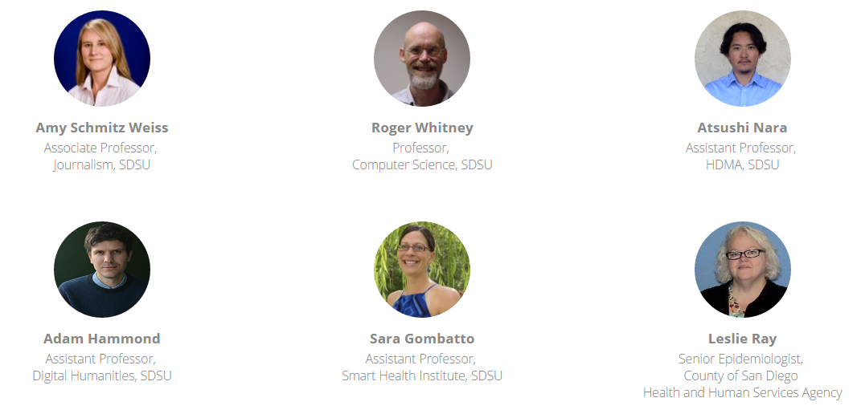
Thanks to our Judge Panel
Prof. Amy Schmitz Weiss (Chair, SDSU Journalism)
Prof. Adam Hammond (SDSU Digital Humanities)
Prof. Atsushi Nara (SDSU GIS and HDMA)
Prof. Roger Whitney (SDSU Computer Science)
Leslie Ray (SD County Health and Human Service Agencies)
Prof. Sara Gombatto (SDSU Smart Health Institute)

